Slide 1
PCM & Airborne Instrumentation Systems

Slide 2
Introduction
The characteristics of a PCM stream are defined in Chapter 4 of the IRIG-106 Standard.
Two classes of PCM formats are discussed in Chapter 4. Class I is the basic simpler type, Class II is more complex, and usually involves more interaction with the ground station.
The PCM streams we utilize contain some of the Class II attributes.

Slide 3
Glossary
ADAU – Analog Data Acquisition Unit
CAIS – Common Airborne Instrumentation System
CDAU – CAIS-compatible Data Acquisition Unit
DAU – Data Acquisition Unit
PCM – Pulse Code Modulation
TDM – Time Division Multiplexing

Slide 4
Pulse Code Modulation (PCM)
Patented in 1938
ITT/France, by Sir Alec Reeves
Benefits
High Accuracy
Digital Implementation means easy interface to computers
Today’s Major Market
Weaknesses
High cost for a low number of channels (but that’s changing with market trends)

Slide 5
What is PCM?
PCM stands for Pulse Code Modulation, and it is a method of encoding analog parameters to a digital quantity.
Chapter 4 of the IRIG-106 Standard defines PCM as the serial bit stream of binary-coded time-division multiplexed words.
This definition will not have any meaning until we define some of the terminology and describe how this serial bit stream is created.

Slide 6
The Multiplexer/Sampler
A Multiplexer/Sampler can put several quantitative measurements over a single output line. The Commutator (shown below) is a mechanical model used to illustrate how a multiplexer/sampler works. As the arm rotates, each parameter is output within in a certain time period. This is known as Time Division Multiplexing (TDM).
PARAMETER A
PARAMETER B
PARAMETER C
PARAMETER D
PARAMETER E
ABCDEFGHABCDEFGHABC…
OUTPUT
PARAMETER F
PARAMETER G
COMMUTATOR
PARAMETER H

Slide 7
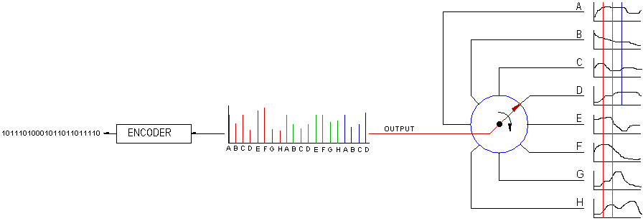
The Entire System
This diagram shows each of the components as a system. The multiplexer/sampler samples each of the signals, the quantizer assigns values to the amplitude of the pulses, and the encoder converts the amplitude value to a binary number, all which are output as a serial bit stream.
Multiplexer/Sampler
Serial
Bit Stream
Encoder
Quantizer

Slide 8
Class I PCM Stream
A PCM stream is defined as the serial bit stream of binary-coded time-division multiplexed words (or parameters).
This definition should make more sense now that the process of creating the PCM stream has been explained.
Serial Bit Stream
001101100110
011101010110
111001110100
011001001110

Slide 9
Bit Rate
The Bit Rate is the rate at which bits of the PCM stream are output within a second. Its units are bits/sec or bps.
For a Class I PCM Stream, the bit rate must be a minimum of 10 bps and maximum of 10 Mbps.
So a PCM stream with a bit rate of 2 Mbps outputs two million bits within a second.

Slide 10
PCM Words
When this serial stream of bits is divided into bit-groups called words, they convey information. Each word is the encoded sample of the parameters.
001101100110
011101010110
111001110100
011001001110
PCM Word

Slide 11
Time Division Multiplex (TDM) in Reference to the PCM Stream
As shown earlier, only one word in the PCM stream is output at a time. For example, the information from Word B is output in the time period of 1 to 2 seconds and the information from Word C is output in the time period of 2 to 3 seconds. This is known as time division multiplexing as the parameters are output one at a time, not simultaneously.
WORD A
WORD B
WORD C
WORD D
001101100110
011101010110
111001110100
011001001110
0sec 1 2 3 4

Slide 12
Word Length
The Word Length is defined as the number of bits per word (bpw).
For a Class I PCM Stream, this can vary from 4 to 32 bits.

Slide 13
Bit Numbering Within a Word
The most significant bit of a PCM word is bit position 1. Subsequent bits are numbered consecutively.
MSB
LSB
. . .
1 2 3 4 n
Be aware that when monitoring other systems and placing their data in a Chapter 4 PCM Stream, their bit numbering may not be the same. You will have to make a conversion chart which maps their numbering to Chapter 4’s numbering. Not properly doing so will cause you to monitor the wrong bits.

Slide 14
Frame Synchronization Patterns
Frame Synchronization (or Frame Sync) patterns are used to define the beginning of the PCM frame.
Without a sync pattern, there is no reference to locate the beginning or end of a PCM stream. It just looks like an unending stream of 1’s and 0’s.
The frame sync pattern length may vary from 16 to 33 bits. In practice, sync words are usually two PCM words in length in order to achieve frame sync patterns greater than 16 bits.
111110101111
001100100000
111001110100
011001001110
FRAME SYNC PATTERN
PCM Word
PCM Word

Slide 15
Frame Synchronization Patterns
Frame sync patterns must be unique, such that two consecutive data words in your PCM stream don’t look like the assigned frame sync pattern.
defined patterns of 1’s and 0’s called Barker Codes are used within frame sync patterns to get various lengths.
Barker codes come in lengths of 2, 3, 4, 5, 7, 11, and 13 bits.
Barker Codes were chosen because they are statistically less likely to appear as consecutive data words within the PCM stream.

Slide 16
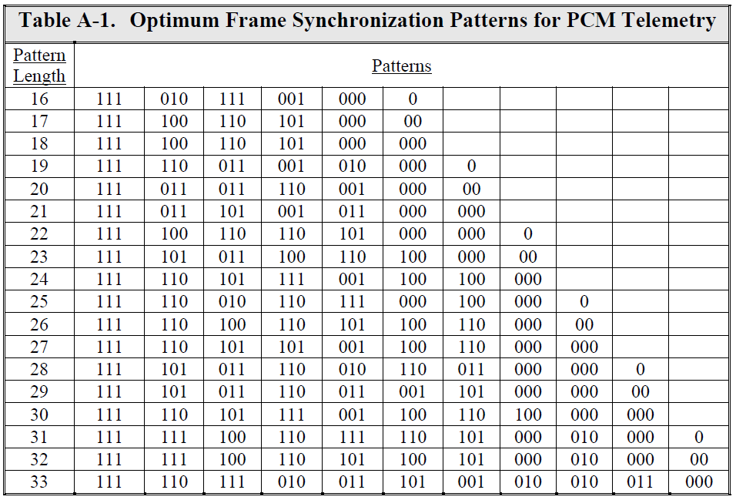
Codes Assigned as Frame Sync Patterns
Table A-1 of Appendix 4-A of the IRIG-106 Standard

Slide 17
Common Frame Sync Patterns
Word Lengths
12 BITS/WD
16 BITS/WD
Bit Pattern
1111 1010 1111 0011 0010 0000
1111 1110 0110 1011 0010 1000 0100 0000
Hex Equivalents
FAF 320
FE6B 2840
Because our data acquisition systems only use 12 and 16 bits, these are the codes we most commonly use.
Chapter 8, which has 24-bit words, utilizes FAF 320.

Slide 18
PCM Map
The PCM Map graphically shows the layout of the words within the PCM stream. It is laid out in a grid as shown below. Each block is a PCM word sample.

Slide 19
Minor Frame
A Minor Frame is the row of words from the beginning of a minor frame sync pattern to the beginning of the next minor frame sync pattern. This particular PCM map has 4 minor frames.
FRAME SYNC 1 | FRAME SYNC 2
FRAME SYNC 1 | FRAME SYNC 2
FRAME SYNC 1 | FRAME SYNC 2
FRAME SYNC 1 | FRAME SYNC 2
Each row is a minor frame in the PCM map.

Slide 20
Major Frame
A Major Frame contains the number of minor frames required to include one occurrence of every word in the format.
FRAME SYNC 1 | FRAME SYNC 2
FRAME SYNC 1 | FRAME SYNC 2
FRAME SYNC 1 | FRAME SYNC 2
FRAME SYNC 1 | FRAME SYNC 2

Slide 21
No Minor Frames?
Some PCM streams have a single minor frame. Therefore the major frame and the minor frame is the same. Although usually it is described as a PCM map that does not have any minor frames.
FRAME SYNC 1 | FRAME SYNC 2

Slide 22
Minor Frame Numbering
The first minor frame in a major frame shall be identified as minor frame 1. The remaining minor frames are numbered sequentially within the major frame.
For a Class I PCM stream, there are at most 256 minor frames in a major frame.
1
2
3
4
FRAME SYNC 1 | FRAME SYNC 2
FRAME SYNC 1 | FRAME SYNC 2
FRAME SYNC 1 | FRAME SYNC 2
FRAME SYNC 1 | FRAME SYNC 2

Slide 23
Subframe Identification
To identify between each of the minor frames within the major frame, a sub frame ID counter is used. It is usually the first word after the frame sync pattern. Depending on the system, this counter can start counting from 0 or 1. The equipment used at AID begins its count at 0.
1
2
3
4
FRAME SYNC 1 | FRAME SYNC 2 | SFID = 0
FRAME SYNC 1 | FRAME SYNC 2 | SFID = 1
FRAME SYNC 1 | FRAME SYNC 2 | SFID = 2
FRAME SYNC 1 | FRAME SYNC 2 | SFID = 3
A sub frame will be described later in this training.

Slide 24
Word Position Identification
The first word after the frame sync pattern shall be word number one. Each minor frame has the same word numbering with each individual word identified by its minor frame location (ex: word 4, minor frame 3). Do not get confused by identifying the location by the sub frame ID counter.
1 2 3 4 5 6
1
2
3
4
FRAME SYNC 1 | FRAME SYNC 2 | SFID = 0
FRAME SYNC 1 | FRAME SYNC 2 | SFID = 1
FRAME SYNC 1 | FRAME SYNC 2 | SFID = 2 |  |  | X
FRAME SYNC 1 | FRAME SYNC 2 | SFID = 3

Slide 25
Word Numbering
Because the first word after the frame sync pattern is designated as word 1, the PCM map is normally shown in this form in data acquisition software. This makes it easier for the person programming the hardware and creating the PCM map.
1 2 3 4 5 6 7 8
1
2
3
4
SFID = 0 |  |  |  |  |  | FRAME SYNC 1 | FRAME SYNC 2
SFID = 1 |  |  |  |  |  | FRAME SYNC 1 | FRAME SYNC 2
SFID = 2 |  |  |  |  |  | FRAME SYNC 1 | FRAME SYNC 2
SFID = 3 |  |  |  |  |  | FRAME SYNC 1 | FRAME SYNC 2
This is a PCM map that is represented from the hardware point of view. RTPS will argue (and would be correct) that the frame sync word comes first, but just keep in mind that we say it comes last so the first word represented is word 1.

Slide 26
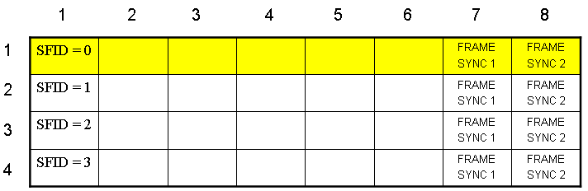
Minor Frame Length
Minor Frame Length is defined as the number of words (including the frame sync pattern) within each minor frame.
For a Class I PCM Stream, the minor frame can be no longer than 8192 bits. For a 12-bit system that is 682 words, and for a 16-bit system that is 512 words. Additionally, no minor frame shall exceed 1024 words.
For our example, the minor frame length is 8 words/minor frame.

Slide 27
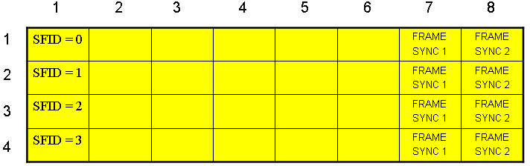
Major Frame Length
Major Frame Length is defined as the minor frame length multiplied by the number of minor frames in the major frame.
In our example, the major frame length is
8 words/minor frame x 4 minor frames/major frame or
32 words/major frame.

Slide 28
Super Commutation
A super commutated word is one which appears more than once in a minor frame. This word must appear in even word intervals. Word D is a super commutated word appearing twice per minor frame in even intervals of 4 word positions.
1 2 3 4 5 6 7 8
1
2
3
4
SFID = 0 | D | E | X | X | D | FRAME SYNC 1 | FRAME SYNC 2
SFID = 1 | D | E | X | X | D | FRAME SYNC 1 | FRAME SYNC 2
SFID = 2 | D | E | X | X | D | FRAME SYNC 1 | FRAME SYNC 2
SFID = 3 | D | E | X | X | D | FRAME SYNC 1 | FRAME SYNC 2
4 1 2 3 4 1 2 3

Slide 29
Sub Frame
A Sub Frame is defined as a group of words in a column which occupy the same minor frame word in each of the minor frames. In this example, the sub frame occupies word 4.
1 2 3 4 5 6 7 8
1
2
3
4
SFID = 0 | D | E | X | X | D | FRAME SYNC 1 | FRAME SYNC 2
SFID = 1 | D | E | X | X | D | FRAME SYNC 1 | FRAME SYNC 2
SFID = 2 | D | E | X | X | D | FRAME SYNC 1 | FRAME SYNC 2
SFID = 3 | D | E | X | X | D | FRAME SYNC 1 | FRAME SYNC 2

Slide 30
Sub Commutation
A Sub Commutated word is one which is sampled at evenly spaced sub multiple rates of the minor frame rate. Parameters F and H are sampled ¼ of the minor frame rate and G is sampled ½ the minor frame rate. A parameter appearing 4 times would be considered to be a minor frame word (parameter E).
1 2 3 4 5 6 7 8
1
2
3
4
SFID = 0 | D | E | F |  | D | FRAME SYNC 1 | FRAME SYNC 2
SFID = 1 | D | E | G |  | D | FRAME SYNC 1 | FRAME SYNC 2
SFID = 2 | D | E | H |  | D | FRAME SYNC 1 | FRAME SYNC 2
SFID = 3 | D | E | G |  | D | FRAME SYNC 1 | FRAME SYNC 2

Slide 31
Class II PCM Stream Differences
Bits Rate higher than 10 Mbits/sec
Word Lengths greater than 32 bits, but less than 64 bits.
Fragmented words
More than 8,192, but less than 16,384 bits/minor frame
Unevenly spaced super commutation
Cyclic Redundancy Checks (CRC)
Format changes
Asynchronous embedded formats
Tagged data formats
Asynchronous data merging

Slide 32
Why Make This So Complex?
This is done so you can have multiple sampling rates to most efficiently utilize the PCM Frame and keep the Bit Rate as low as possible. Vibration measurements require high sample rates, temperature measurements require low sample rates.
Super Commutation - for high sample rates
Minor Frame words - for upper medium sample rates
Super Sub Commutation - for lower medium sample rates
Sub Commutation - for lower sample rates

Slide 33
Airborne Instrumentation
Many vendors, both US and international
Two system level architectures
Central
Distributed
ARINC-429
Sensors
Setup
Control
PCM out
Commutator
MIL-STD-1553
Servos
Discretes
Voice

Slide 34
Airborne Instrumentation, cont.
Distributed architecture
CAIS
Common Airborne Instrumentation System
DAU
DAU
DAU
DAU
DAU
DAU
Setup
Control
PCM out
CAIS Bus Controller Commutator
DAU
DAU
DAU

Slide 35
Airborne Instrumentation, cont.
CAIS Party Line (Control Bus)
Command
Response
10 Mbps — Differential
up to >400,000 sps
up to 63 DAU’s supported
Uses Manchester II Bi-Phase PCM to XMIT instruction and data

Slide 36

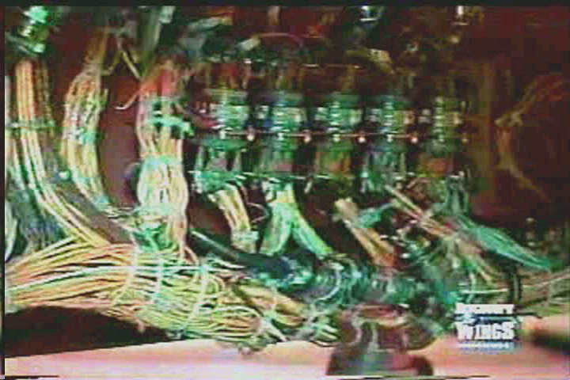
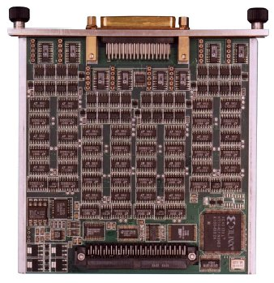
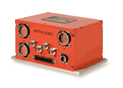
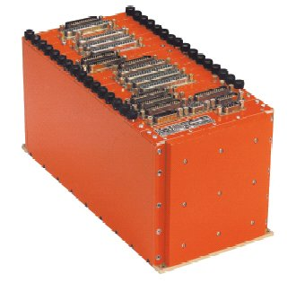
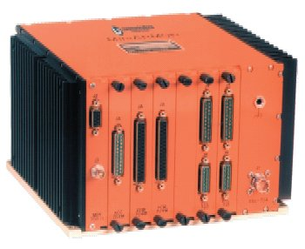
Airborne Instrumentation, cont.

Slide 37
Airborne Hardware (PCM)
CAIS Hardware is a family of modular data acquisition, processing and control units and related support equipment
The modular design allows the system to be tailored for size, cost and test requirements.
The basic system consists of a programmable system controller which communicates to both analog and digital units via the high speed communication bus (CAIS party line)
The remote devices interface to a wide variety of transducers
State of the art multiplexing techniques, standard components, and proven designs are combined to make instrumentation systems.

Slide 38
Airborne Hardware (PCM)
System Controller
Uses CAIS Party line to control and communicate to remote units.
Maintains time coherence by filling all unused words with filler pattern
The system controller is responsible for all format synchronization
Provides PCM out to multiple devices including recorders and TM Links.
Typically can store up 16 different formats selectable through software or discrete control lines.
Remote Units
Accepts analog data from transducers and signal conditioning.
Remote Units sample, amplifies and encodes the data.
Amplification occurs through two stage process.
Signal can have an offset applied to correct range requirements.

Slide 39
AIRBORNE INSTRUMENTATION SYSTEM
COMMAND PARTY LINE
ADAU
SCU
RUD POS
REPLY PARTY LINE
MEMORY
HYD PRESS
MEMORY
STICK FORCE
PCM
OAT
RUD
FRID
S
S
NOR ACCEL
OAT
FUEL TEMP
INLET TEMP
DISCRETE WORD
CODE
AOA
PLUG
AOS
ADDRESS
016
SYNCH
017
SYNCH
ADDRESS
FDW1
FDW2
FDW3
FDW4
018
FRID
001
019
DAU 1 001
RUD POS
RUD POS
002
020
SUBCOM 100
HYD PRESS
021
SUBCOM 200
STICK FORCE
003
022
DAU 1 002
HYD PRESS
NOR ACCEL
004
023
DAU 1 003
STICK FORCE
OAT
005
024
DAU 1 001
RUD POS
FUEL TEMP
006
025
DAU 1 004
NOR ACCEL
INLET TEMP
007
100
DAU 1 005
OAT
DISCRETE WORD
008
FRID
101
DAU 1 006
FUEL TEMP
AOA
009
102
DAU 1 007
INLET TEMP
AOS
000
103
DAU 1 008
DISCRETE WORD
FRID
200
DAU 1 009
AOA
201
DAU 1 010
AOS

Slide 40
AIRBORNE INSTRUMENTATION SYSTEM
FULLY PROGRAMABLE
BITS/WORD: 10, 12, 14, 16 BITS
BIT RATES: 2.5 KBITS TO 40.0 MBITS
FAMILY SIG COND
TRANSDUCER EXCIT SUP
ANALOG DATA FILTER
RESISTIVE TEMPERATURE
SENSOR CONDITIONER
PHASE SENSITIVE DEMODULATOR
SYNCHRO/RESOLVER CONVERTER
PARALLEL DISCRETE MODULE
SERIAL DIGITAL COND
FREQ/PULSE TOTALIZER
ANALOG ATTENUATOR
CONTROL SIG GENERATOR
TO TRANSMITTER
TO DATA RECORDER
TO DATA RECORDER
FUNCTIONAL BLOCK DIAGRAM

Slide 41
AIRBORNE INSTRUMENTATION SYSTEM
EXAMPLE: GAIN & OFFSET
GAIN
OFFSET
GAIN
EU
TRANSDUCER
GAIN
OFFSET
10 G
10 G
10 G
0 G
10.1 MV
1.01 VOLT
1.0 VOLT

Slide 42
PCM FORMAT LAYOUT
PARAMETER LOCATION
HOW TO DETERMINE BIT RATE
ASSUME 10 BITS/WORD
DATA RATE:
RUD POS 40 SPS
HYD PRESS, STICK FORCE, NOR ACCEL, 20 SPS
OAT, FUEL TEMP, INLET TEMP, DISCRETE WORD, 5 SPS
AOA, AOS 10 SPS
WORD
FRAME
BIT
RUD
POS
3, 8
0
OAT (OUTSIDE AIR TEMP)
4
0
FUEL TEMP
4
1
INLET TEMP
4
2
AOA (ANGLE OF ATTACK)
5
0
AOS (ANGLE OF SIDESLIP)
–
–
HYD PRESS
–
–
STICK FORCE
–
–
NOR ACCEL
–
–
DISCRETE WORD
4
3
1 PAR X 40 SPS X 10 BIT/WORD = 400 BPS
3 PAR X 20 SPS X 10 BIT/WORD = 600 BPS
4 PAR X 5 SPS X 10 BIT/WORD = 200 BPS
2 PAR X 10 SPS X 10 BIT/WORD = 200 BPS
2 SYNCH X 20 SPS X 10 BIT/WORD = 400 BPS
1 FRID X 20 SPS X 10 BIT/WORD = 200 BPS
2000 BPS
GEAR DOWN
4
3
1
TAPE RECORDER OFF
4
3–
2
TAPE RECORDER OFF
GEAR DOWN
10
9
8
7
6
5
4
3
2
1
DISCRETE WORD

Slide 43
AIRBORNE INSTRUMENTATION SYSTEM
FIXED WORDS
FORMAT REQUIREMENT:
COMPUTE BIT RATE:
177 PARS X 10 BITS/WORD X 100 SPS = 177,000 BPS
30 PARS X 10 BITS/WORD X 10 SPS = 3,000 BPS
2 SYNCH X 10 BITS/WORD X 100 SPS = 2,000 BPS
1 FRID X 10 BITS/WORD X 100 SPS = 1,000 BPS
183,000 BPS
177 PARS @ 100 SPS
30 PARS @ 10 SPS
10 BITS/WORD
COMPUTE FIXED WORDS
183W X 10 B/W X 100 SPS + FW X 10 B/W X 100 SPS = 200,000
200,000 – 183,000
1000
FW =
FW = 17

Slide 44
IRIG 106 Chapter 8 Total Bus Capture
FRAME STRUCTURE
256 Words x 1 Frame
24 Bits / Word
Sync = FAF320
Programmable Bit Rate
DATA ORDER
Word 1 = Sync
Word 2-4 = Embedded Time
Data = FIFO
WORD STUCTURE
24 Bits
First 8 bits Identify Word Type and Bus
Command, Status, Data, Time, Filler
4
3
2
1
H009 1/3
H009 2/4
WEAPONS
AVIONICS
Hi - Speed Digital Monitor
CONFIGURATION
PCM STREAM
WORD 1
<<< Msg from Bus 1 >>>
SYNC
TIME H
TIME L
TIME u
CW
TIME u
<<< Msg from Bus 4 >>>
< Msg from Bus 1Cont >
CW
TIME u
DW1
FILLER
DW2
DW3
< << Msg from Bus 4Cont >>>
WORD 256
DW2
DW3
DW4
DW5
........
FILL

Slide 45
Questions?

